Slide 1

Fall Prevention
Fall Prevention in Construction
This material was produced under grant number 2018-0555/SH-31199-17-60-F-37 from the Occupational Safety and Health Administration, U.S. Department of Labor. It does not necessarily reflect the views or policies of the U.S. Department of Labor, nor does mention of trade names, commercial products, or organizations imply endorsement by the U.S. Government.
Notes:
Title: Fall Prevention in Construction
Description: This presentation was specifically designed to be used with young construction workers (ages 18-25). The training techniques were selected in an effort to enhance effectiveness with this age group by incorporating technology, micro-learning, collaboration and simplicity of design. As a trainer, you may want to add additional content.
Number of Participants: 4 - 24
Length: 2 – 2.5 Hours if presented in total. It can also be presented as separate, shorter modules.
Materials Needed:
PowerPoint Slides
Screen or monitor large enough for room and group size
Internet Connection
Audio capability (for videos)
Cell phones, tablets or computers with access to the internet
Ladders (optional)
2 – 6 Personal Fall Arrest Harnesses (optional)

Slide 2

Objectives
After completing the training, participants will be able to:
Recognize 4 common construction site hazards
List 4 facts about falls on construction sites
Identify 5 rights American workers have
Describe 6 safe ladder use practices
Demonstrate how to inspect and put on a PFAS
Access factors that contribute to scaffold accidents
Notes:
Instructor Note: Review the objectives of the course as presented on the slide.

Slide 3
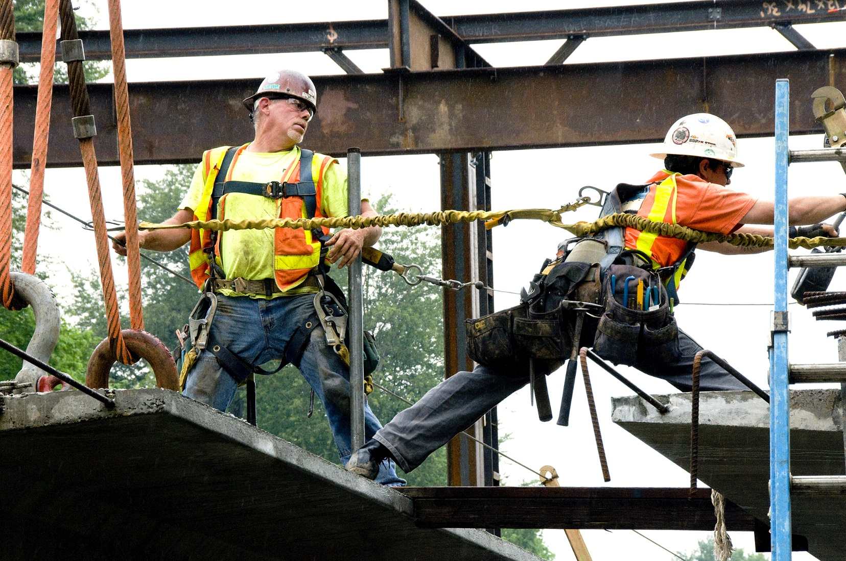
Construction is Dangerous Work
Introduction
Notes:
Script: Construction is a high hazard industry that involves a wide range of activities: residential construction, bridge erection, roadway paving, excavations, demolitions, and large scale painting jobs. Construction workers engage in many activities that may expose them to serious hazards, such as falling from rooftops, unguarded machinery, being struck by heavy construction equipment, electrocutions, silica dust, and asbestos.
Our goal today is to spend a little time looking specifically at construction work and the risk for falls. As we get started, let’s consider some facts…
Image Source: Oregon Dept of Transportation https://commons.wikimedia.org/wiki/File:Beam_work_(7415281734).jpg

Slide 4
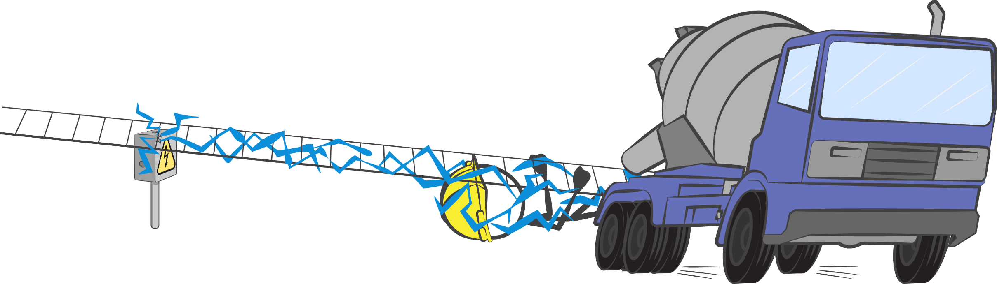
The Four Most Common Hazards
Falls
Struck by
Electrocution
Caught-in/Between
Notes:
Script: The 4 most common hazards on a construction site are falls, followed by struck by object, electrocution, and caught-in/between. These "Fatal Four" were responsible for more than half (63.7%) the construction worker deaths in 2016. (BLS report)
Falls — 384 out of 991 total deaths in construction in CY 2016 (38.7%)
Struck by Object - 93 (9.4%)
Electrocutions - 82 (8.3%)
Caught-in/between* - 72 (7.3%)
(*This category includes construction workers killed when caught-in or compressed by equipment or objects, and struck, caught, or crushed in collapsing structure, equipment, or material)
Eliminating the Fatal Four would save more than 600 workers' lives in America every year.

Slide 5
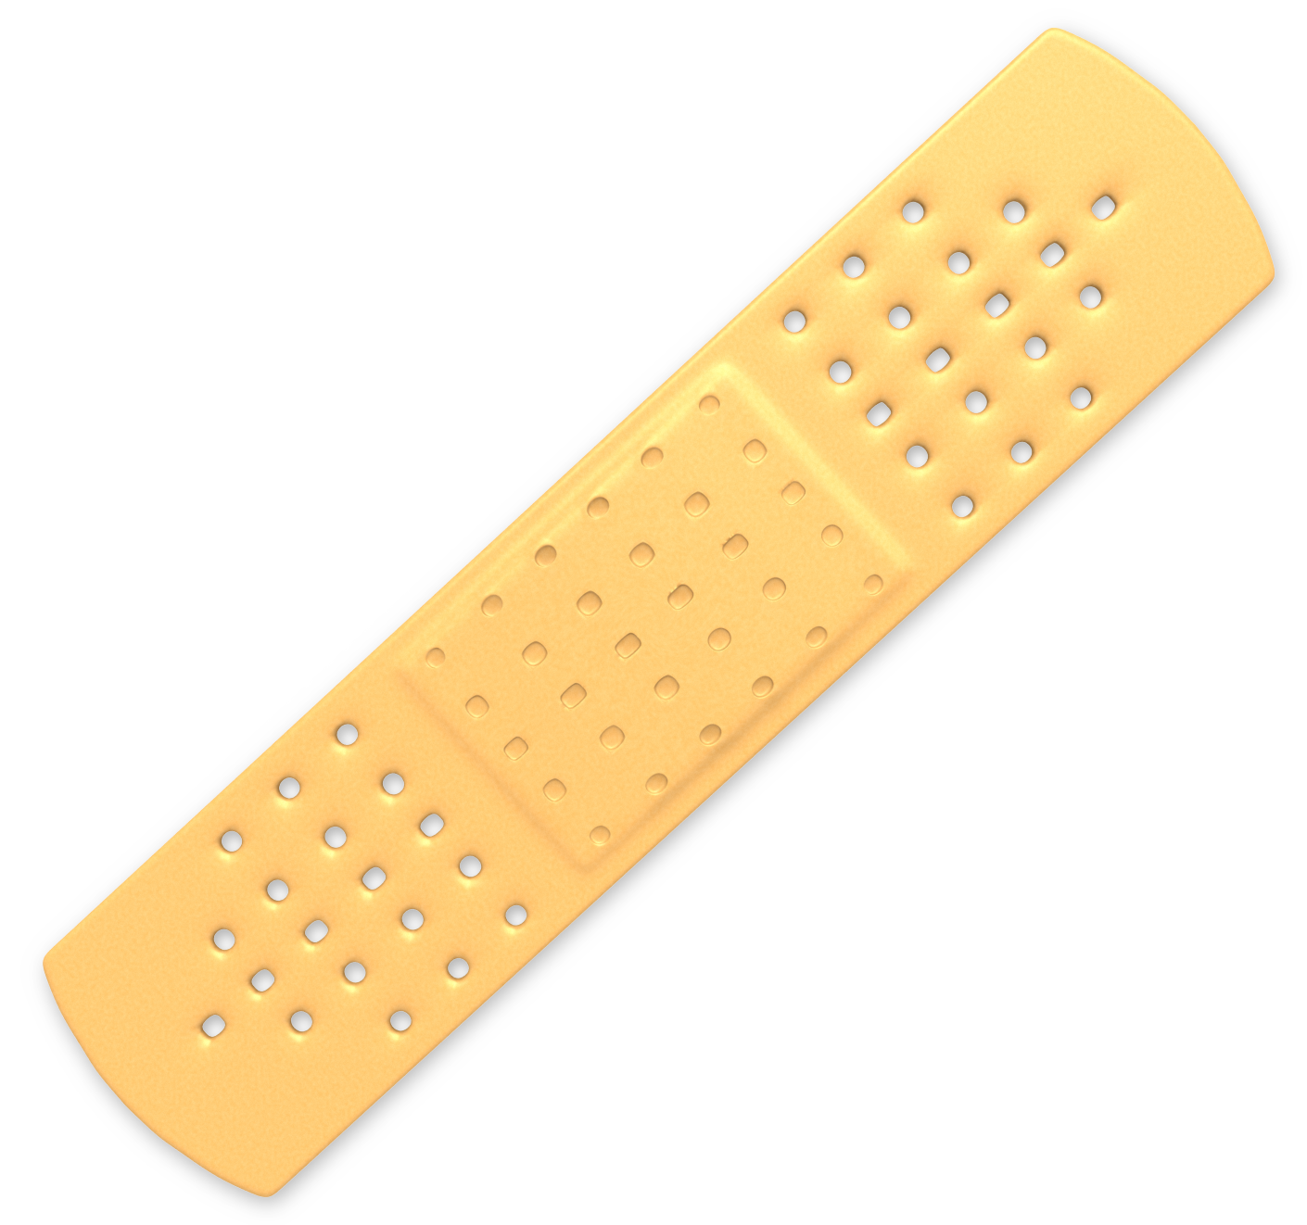
Emergency Room Data…
Work-related injury rate
< 25
2X higher
than workers > 25
Notes:
Script: When it comes to workplace injuries and illnesses, younger workers are at greater risk than older workers. Information provided on OSHA’s website, indicates that in 2014, the injury rate for workers under age 25 was approximately two times higher than for workers 25 years and older, based on emergency room data.
Pose the question: Why do you think that’s the case? Allow time for ideas and discussion. Possible answers could include:
Younger workers might be doing the more physically demanding or even more dangerous tasks
Older workers might be in the more supervisory positions.
Older workers have more experience, have learned from their mistakes.
Instructor note: Make sure the conversation ends with an emphasis on the fact that regardless of the reasons, younger workers experience more injuries and those injuries can impact them for the rest of their lives.
Image Source: Presentermedia.com
https://www.presentermedia.com/index.php?target=closeup&id=2121&categoryid=133&maincat=clipart

Slide 6
Injury & Illness Rates
3.4
1.3
15-17
18-24
25-34
35-44
45-54
55-64
65+
Notes:
Script: This is another way to look at the same detail – Workers aged 15-24 are approximately twice as likely to be injured on the job.
Instructor Note: There are animations on this slide. Click to reveal numbers and arrows.
Additional Information:
Rates of Work-Related Injuries and Illnesses Treated in Emergency Departments by Age Group, United States, 2014
This graph shows rates for work-related nonfatal injuries and illnesses treated in emergency departments by age group in the United States for 2014. The highest rate is seen for workers 18 to 24 years of age, with a rate of 3.4 injuries and illnesses per 100 fulltime equivalents. The next highest rate is seen for workers 15 to 17 years of age, with a rate of 3.0 injuries and illnesses per 100 fulltime equivalents. Rates decline for older age groups from a rate of 2.4 injuries and illnesses per 100 fulltime equivalents for workers 25 to 34 years of age to a rate of 1.3 for workers 65 years and older.(Source: National Electronic Injury Surveillance System (NEISS)- NIOSH Work Supplement.)

Slide 7
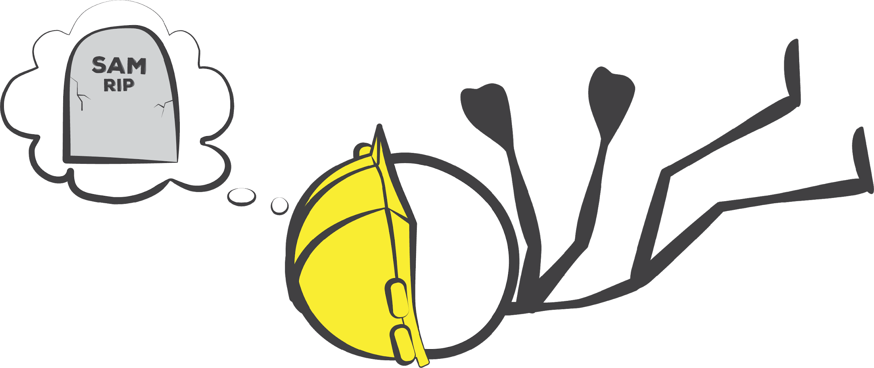
20% of American workers killed on the job are construction workers.
Notes:
Script: If we look at the types of workers dying as a result of job-related accidents, we quickly discover that construction work is indeed dangerous work! One out of every 5 job-related deaths is a construction worker..

Slide 8

The Facts on Falls
#1 cause of death for construction workers.
1 out of 4 involve ladders.
Height DOES NOT matter.
Notes:
Script: And if we keep examing the data, we find that falls are the #1 cause of death for construction workers. Furthermore, ladders are partiicularly dangerous and height isn’t really a factor at all.
Segue: We’re gonna take a look at a short video to summarize the fact that construction work is dangerous and falls are a particular concern…..

Slide 9
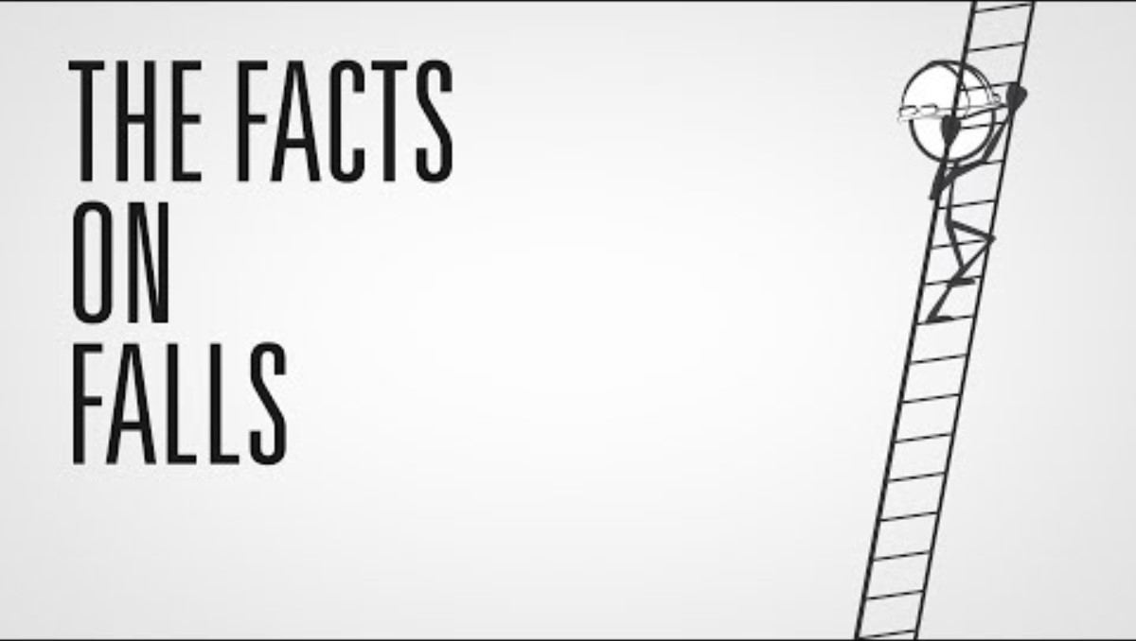
Video: Construction Work is Dangerous
Notes:
Instructor Note: This video (1 min, 11 sec) summarizes the key points from slides 4-8. To play, click the play button (triangle) at the bottom left corner of the screen. The video is also located at: https://www.youtube.com/watch?v=SZ_S197ERDc

Slide 10

Your Rights as an Employee
Safe workplace
Info on hazardous chemicals
Info about injuries and illnesses
Complain
Training
Exposure and medical records
File a complaint with OSHA
Participate in inspections
Be free from retaliation
Notes:
Script: As we continue to explore fall hazards on construction sites, it is important that you understand that employers are required to provide a safe workplace for all American workers. In fact OSHA was created to ensure that you can feel comfortable and confident that your employer will protect you from job-related hazards. The OSH law also gives workers important rights to participate in activities to ensure their protection from job hazards.
Instructor Note: Briefly review the list of worker rights on the screen and refer participants to the handout entitled “Employee Responsibilities & Rights,” for additional information.
Image source: OSHA.gov

Slide 11

Key Topics
Notes:
Script: Our focus for this module will be to explore the hazard of falls in construction work. We will spend tome on each of these 3 key topics:
Ladders,
Personal Fall Arrest Systems (PFAS), and
Scaffolds

Slide 12

Ladder Safety
Notes:
Module Title Slide: Ladder Safety

Slide 13


Hit Me Up!
HMU!
Ladder Safety Rules
Search for:
“OSHA Quick Card Portable Ladder Safety PDF”
Review the Information.
Notes:
Script: Take out your phones (or tablets, computers) and search the internet for the phrase on the screen – “OSHA Quick Card Portable Ladder Safety PDF.” You should be able to locate the OSHA Quick Card that looks like the one displayed on the screen. Once you find it, review the information. I’m going to give you 2-3 minutes to review and then we’ll see if you can identify some ladder safety issues captured in some job site photos.
Instructor Note: Including “PDF” in the search will ensure that the version of the Quick Card is one that will display nicely on their phone screens. Check in with participants to be certain everyone has found the right resource. You may want to have some hard copies of the Quick Card (provided with course materials) as a back-up for anyone who doesn’t have a device or in the event the internet connection isn’t working

Slide 14
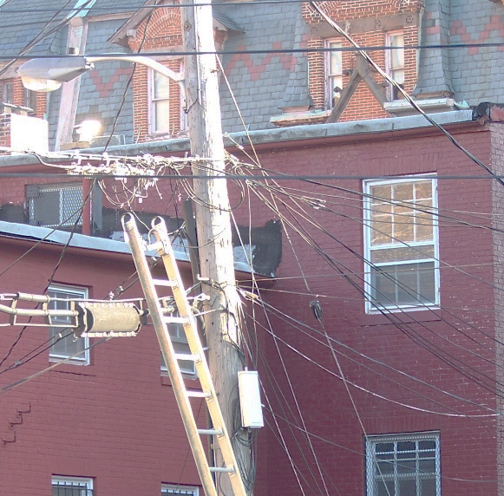

Hit Me Up #1
Avoid electrical hazards
Notes:
Script: Ok! Hit me Up! What did you see on the Quick Card that would apply to this ladder?
Instructor Note: Allow time for response before clicking to reveal answer.
Image source: https://www.flickr.com/photos/spike55151/2965564622/in/photolist-5w4i3w-8gBi7a-iGHbU2-au5PnY-9bvkyg-297QTEd-4c3u11-fLwHix-8b9sFb-bPfaHP-cUeK5G-5tVrr5-dTqHox-dnFZn1-ercAAx-qFhmN6-DcGXCQ-drKHcq-qZARw1-dombx5-pJFgsn-jqYcYf-gAySxG-pJFiqk-gAyMks-Y32FrE-au5G8J-8ZNkgt-5wEd1i-7k9GV1-WqMRaH-52ekBS-o9JGN3-rsW6RD-4UEBQP-8iYo3w-SVkApR-fLXL35-qjWPXD-dm8KJK-Vcq54s-e3UpG4-bL3rDH-4UJQJu-ecp39T-rcTiKc-8j18QD-fLPmfA-edUyxP-amZA6c

Slide 15
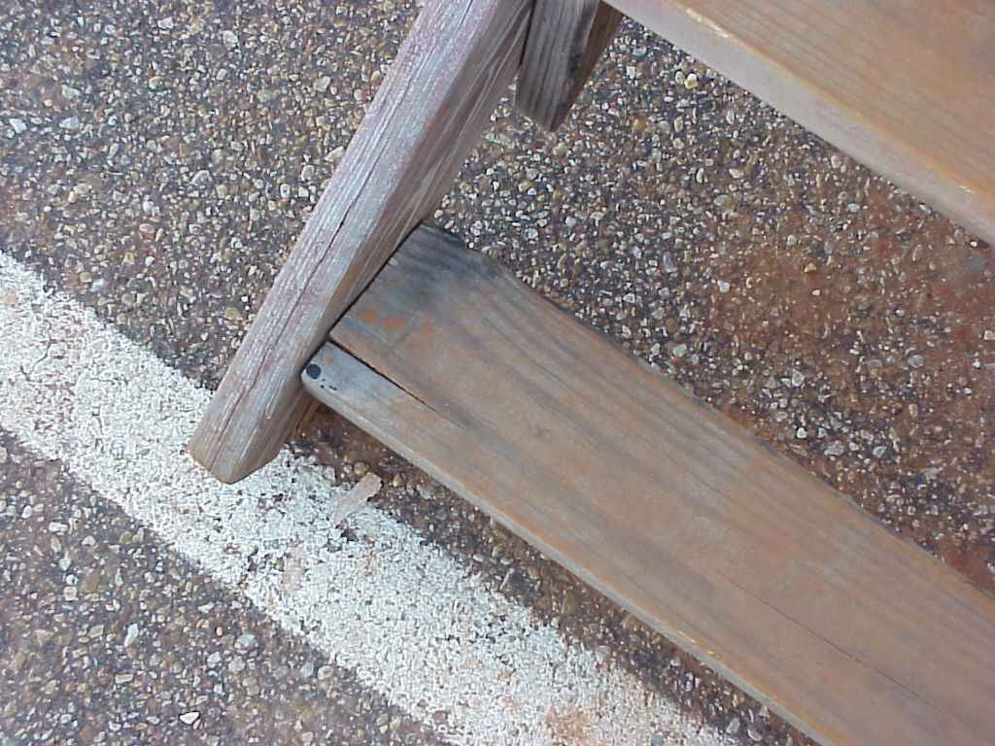
Hit Me Up #2
Inspect rungs
Notes:
Script: Hit me Up! What did you see on the Quick Card that would apply to this ladder?
Instructor Note: Allow time for response before clicking to reveal answer.
Image Source: TEEX Harwood

Slide 16
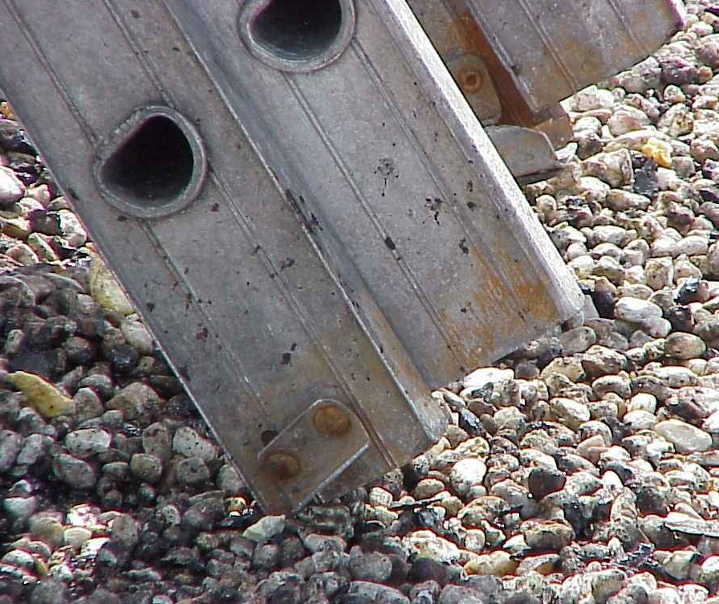
Hit Me Up #3
Inspect cleats
Notes:
Script: Hit me Up! What did you see on the Quick Card that would apply to this ladder?
Instructor Note: Allow time for response before clicking to reveal answer. The cleat highlighted in yellow is missing. The cleat highlighted in green is OK.
Image Source: TEEX Harwood

Slide 17
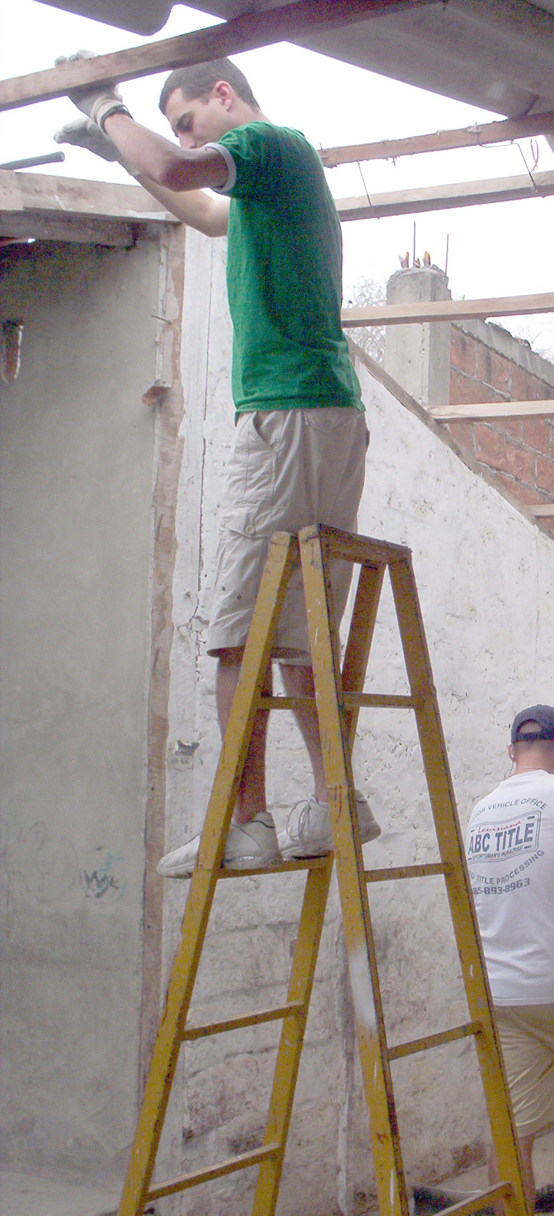
Hit Me Up #4
Face the ladder
Notes:
Script: Hit me Up! What did you see on the Quick Card that would apply to this ladder?
Instructor Note: Allow time for response before clicking to reveal answer.
Image Source: https://upload.wikimedia.org/wikipedia/commons/0/0a/US_Navy_060814-N-4040H-002_Boatswain_Mate_2nd_Class_Randall_McNeil%2C_left_and_Hull_Technician_Fireman_Alex_Anderson%2C_right%2C_balance_on_ladders_as_they_begin_the_demolition_of_the_old_roof_over_the_kitchen_for_the_Jorge_Washingt.jpg
This Image was released by the United States Navy with the ID 060814-N-4040H-002

Slide 18
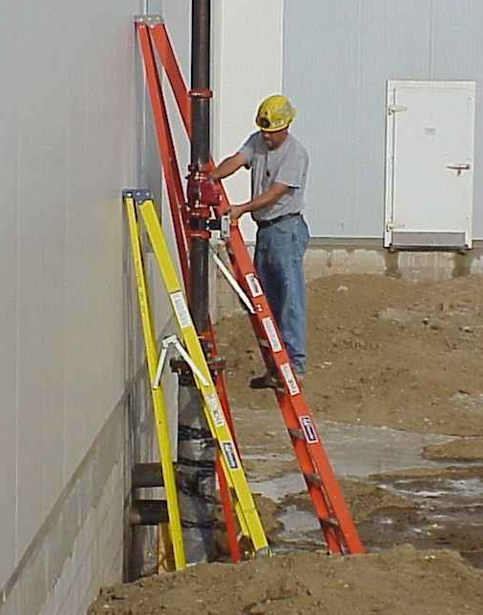
Hit Me Up #5
Self-supporting ladder should not be used as a single ladder
Notes:
Script: Hit me Up! What did you see on the Quick Card that would apply to this ladder?
Instructor Note: Allow time for response before clicking to reveal answer.
Image Source: TEEX Harwood

Slide 19
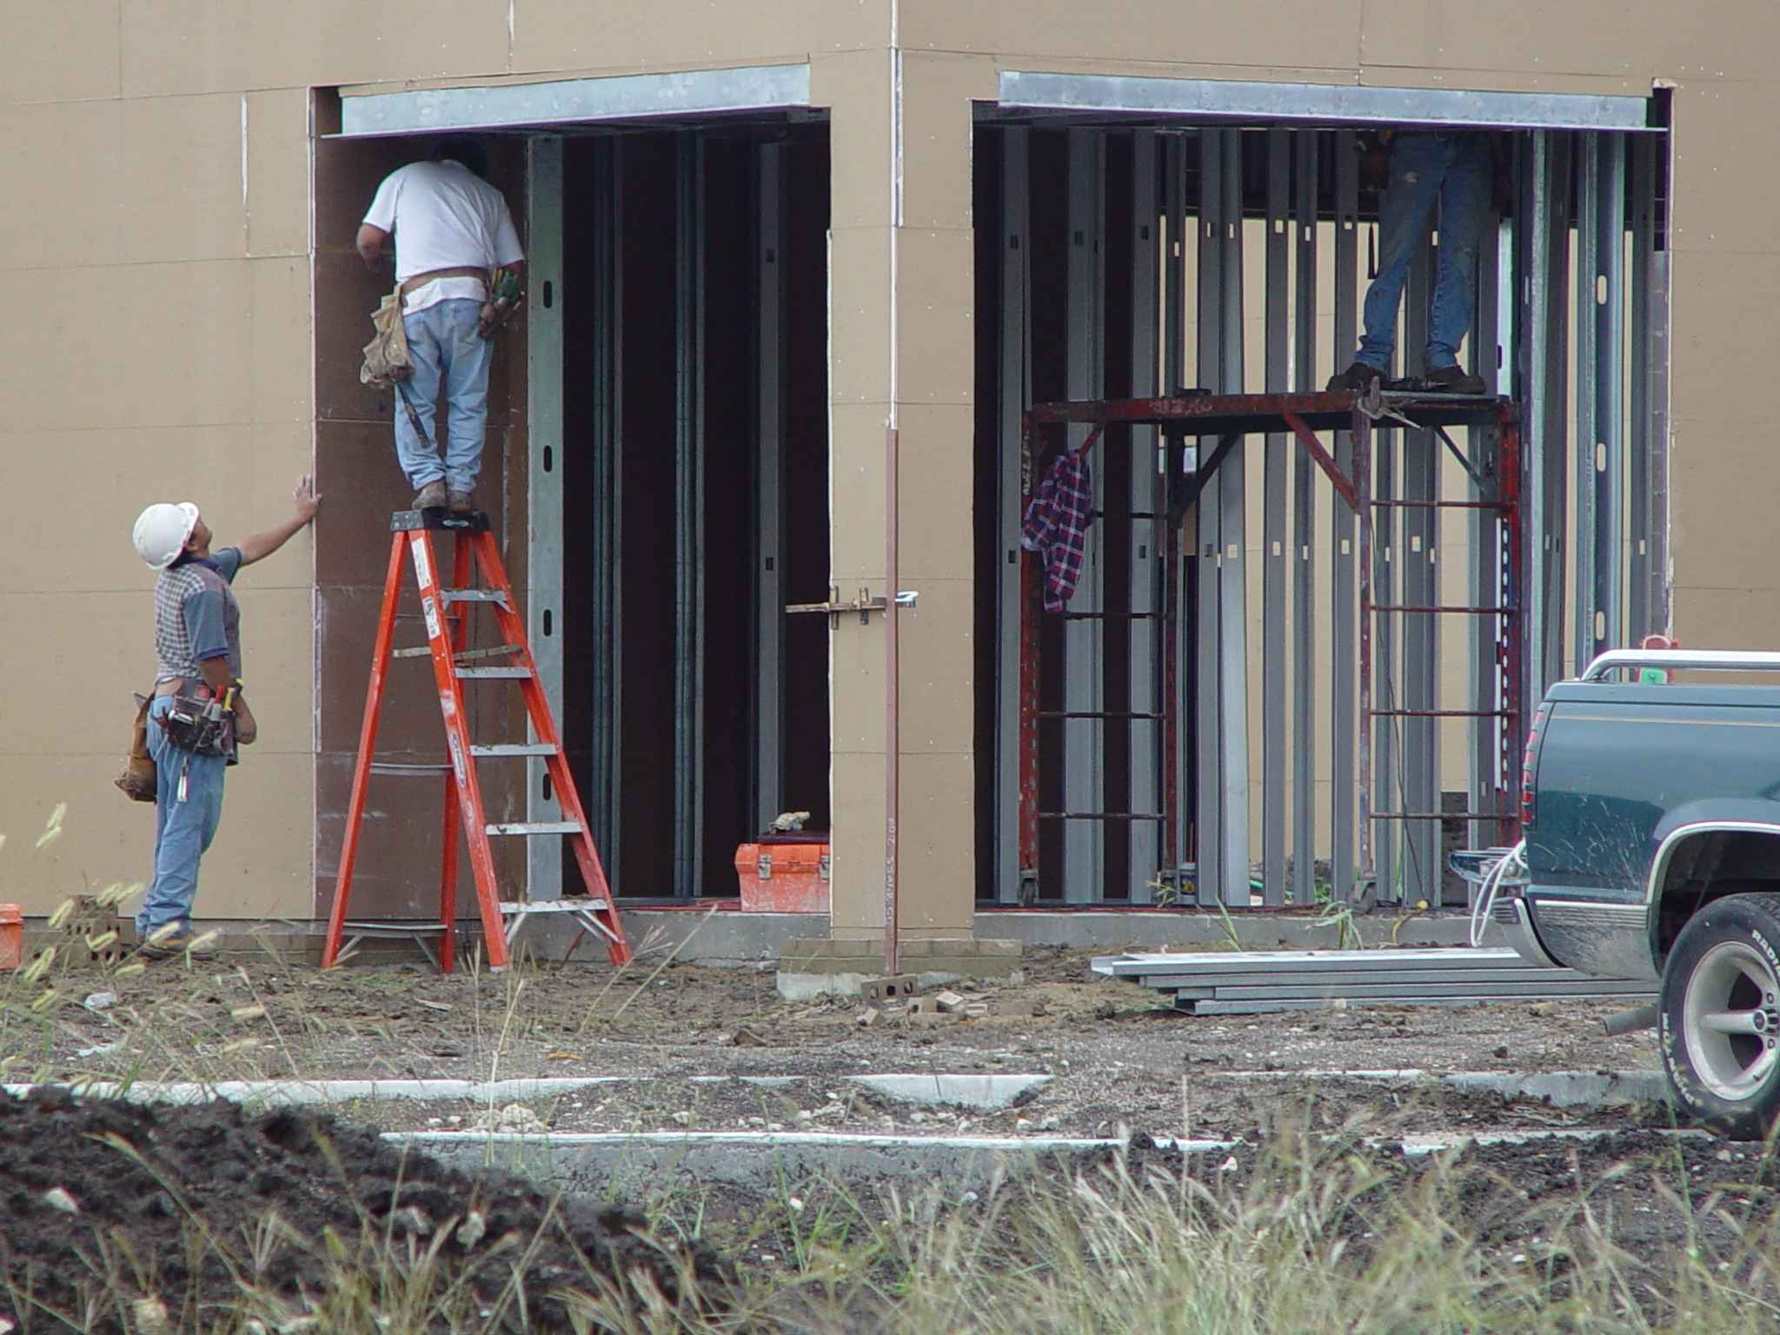
Hit Me Up #6
Do not stand on top step
Notes:
Script: Hit me Up! What did you see on the Quick Card that would apply to this ladder?
Instructor Note: Allow time for response before clicking to reveal answer.
Image Source: TEEX Harwood

Slide 20
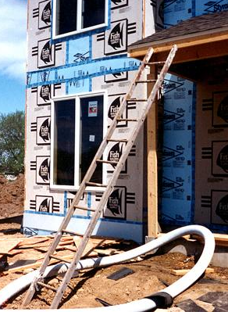
Hit Me Up #7
Surface should be level
3 rungs should be “in the air”
Proper angle of lean is 1:4
Notes:
Script: Hit me Up! What did you see on the Quick Card that would apply to this ladder?
Instructor Note: Allow time for response before clicking to reveal answer.
Image source: OSHA

Slide 21


For the Win!
NIOSH Ladder Safety App
Notes:
Script: On your phones you can use the app store to find the NIOSH Ladder Safety App. It provides a lot of ladder safety tips as well as a tool that you can use to measure the angle of a ladder to make sure it’s set up correctly.

Slide 22
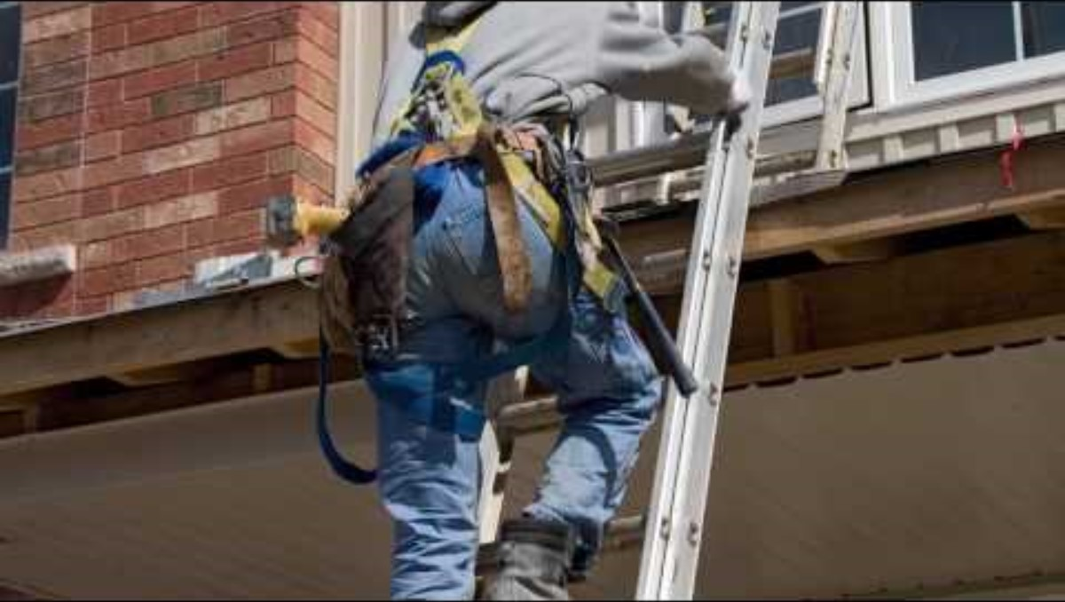
Video: Ladder Safety
Notes:
Instructor Note: This video (1 min, 50 sec) summarizes some key points related to ladder safety. It is located at: https://www.youtube.com/watch?v=-MSaVKc7HAc

Slide 23

Personal Fall Arrest
Notes:
Module Title Slide: Personal Fall Arrest

Slide 24


In Real Life!
IRL!
Personal Fall Arrest
Search for:
“Fall Protection Tips: How To Put On Your Harness”
Published by International Safety
Notes:
Script: A personal fall arrest system (PFAs) is one option of protection for workers on construction sites who are exposed to vertical drops of 6 feet or more. If you are going to rely on a PFAS to protect you from injury or even death, it is critical that you understand how to use one correctly. Using your phone, tablet or laptop, find this video on YouTube – search for “Fall Protection Tips: How to Put on Your Harness.” It should look like the image on the phone displayed on the screen. Take a look at this quick demonstration.
Instructor Note: If you have access to PFASs distribute them to small groups and have them practice putting on a harness as described in the video.
This video (1 min, 26 sec) summarizes and demonstrate the steps for correctly putting on a PFAS. It is located at: https://www.youtube.com/watch?v=u0mz9cd7Ym4&t=2s
Image Source: Presenter Media

Slide 25
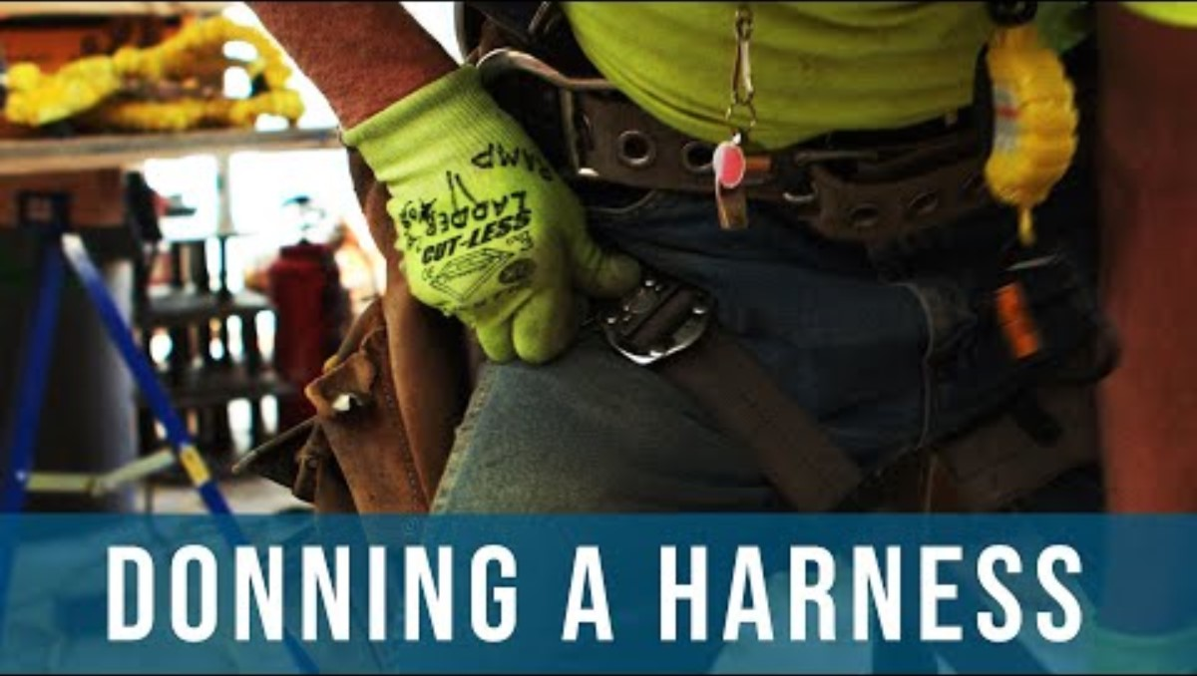
Steps for Putting on a PFAS
Notes:
Script: Based on the video, what are the steps for putting on a PFAS?
Instructor Note: This slide is designed so that you can type participant responses into the text box. Click inside the box and you can type their responses (in the same way you might write their responses on an easel pad). When you are finished, simply click outside of the text box to advance to the next slide. If you are not able to use the active slide text box, you can capture responses on a flipchart or whiteboard.
Here are the steps presented in the video.
Pick up the harness by the D-ring
Shake it out
Inspect it (webbing, stiches, hardware, tags)
Put it on over your shoulders
Center the D-ring between shoulder blades
Fasten the chest strap
Pull leg straps around each thigh
Adjust shoulder straps to be snug
Adjust chest strap – snug and comfortable
Previous video is no longer active (https://www.youtube.com/watch?v=u0mz9cd7Ym4&t=2s). New video linked: https://www.youtube.com/watch?v=t4ArkllkQfs

Slide 26

Scaffold Safety
Notes:
Module Title Slide: Scaffold Safety

Slide 27
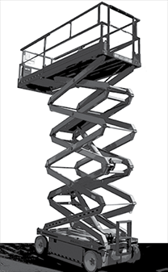
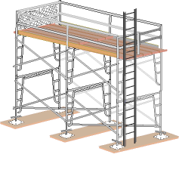
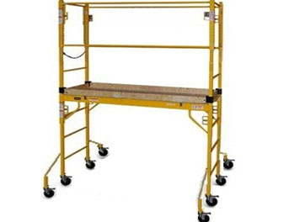
Scaffolds
Notes:
Script: A scaffold is an elevated, temporary work platform.. They are regularly used on all types of construction job sites and every year dozens of workers die and hundreds more are injured as a result of falls from scaffolds. Scaffolds come in a variety of shapes and sizes. Some of the most common include:
Supported Scaffolds
Mobile Scaffolds
Scissor lifts and aerial lifts can also be considered a type of scaffold.
Image Source: OSHA.gov

Slide 28
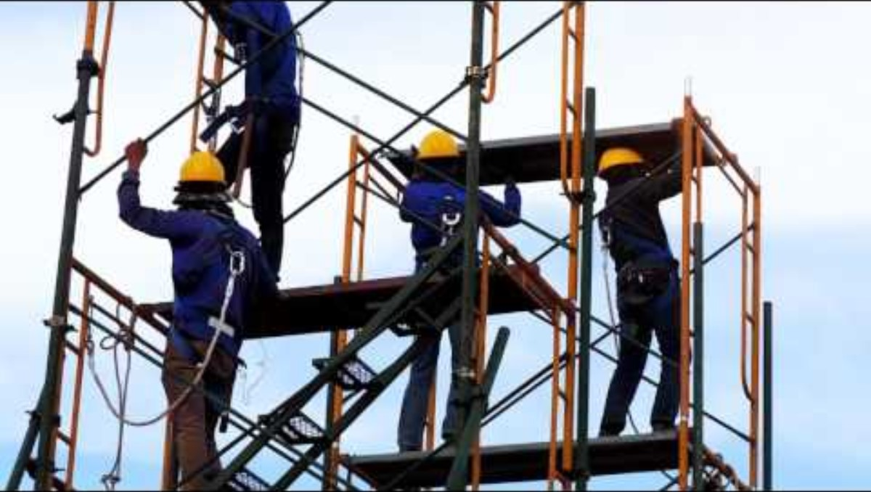
Video: Scaffold Safety
Notes:
Script: We are going talk about some of the things that can go wrong with scaffolding and result in accidents, injures and even death. As we begin, let’s take look at another quick video that provides some basic scaffold safety information.
Instructor Note: This video (approx. 2 min) summarizes some key points related to scaffold safety. It is located at: https://www.youtube.com/watch?v=adCS7uhbXEw

Slide 29
In Real Life!
Scaffolds and Fatalities
IRL!
OSHA.gov
Click “MENU”
Scroll down to “Data and Statistics”
“Fatality and Catastrophe Investigation Search”
Scroll down to “Keyword List;” select “S”
Select “Scaffold”
Notes:
Script: Let’s take a look at some “real life” scaffold accidents that resulted in worker fatalities. Take out your phones and follow the instructions on the screen. This is will take you to a list of workplace accidents involving scaffolds. As you scroll through the list, do you see anything that surprises you?
Instructor Note: The Information Icon at the bottom of the screen is linked to the search results that participants should be seeing on their devices. You may want to pull it up as the class discusses what they are seeing. Be mindful that this list is dynamic and will change as OSHA updates the investigated cases, therefore the cases listed may be different from class to class.
URL for OSHA’s Scaffold Accident Search: https://www.osha.gov/pls/imis/AccidentSearch.search?acc_keyword=%22Scaffold%22&keyword_list=on

Slide 30

How Does it Happen?
Notes:
Script: This quick video reviews a scaffold accident that resulted in a worker’s death. It walks through some of the details that were discovered in the accident investigation. After the video, I want you to work with a partner (or 2), select one of the accidents on the list we were just looking at, and discuss how it could have happened – more on that later, for now let’s look at an example of how scaffold accidents happen.
Instructor Note: This video (approx. 3 min) reviews the details that were factors in a particular scaffolding accident. It is located at: https://www.osha.gov/dts/vtools/construction/scaffolding_fnl_eng_web.html and is available in English and Spanish
https://www.youtube.com/watch?v=-_HCde2jI34

Slide 31
Hit Me Up!
Scaffold Safety
HMU!
Select an event from the list of accidents and consider these questions as you create a story describing what might have happened:
On what type of job site did this happen?
What type of scaffold was being used?
What actions or conditions contributed to the accident?
How could this accident have been prevented?
Notes:
Script: Take out your phones (or tablets, computers) and go back to the Accident Search we were just looking at. In groups of 2-4, select one of the accidents from the list and work together to create a story that might explain what happened. If you click on “Summary Nr” more information is often provided. The questions on the screen will help guide your discussion. I’m going to give you about 10 min to develop your story and then each group will have an opportunity to share.
Instructor Note: This activity is meant to encourage participants to imagine the types of factors that could have contributed to the accident. Some groups may need encouragement or idea prompts. Ensure them that you are not looking for a “right” answer…..you just want to get them to think about the types of things that could go wrong . Also -- there is an optional worksheet with the discussion questions included in the course materials. You may elect to use the worksheet to help groups organize their stories about what might have happened.

Slide 32
Construction is Dangerous Work
Summary
Notes:
Script: In summary – Construction work is dangerous work and falling is a big concern. Every worker should be trained on how to recognize fall hazards and protect themselves through the correct use of equipment, including ladders, fall arrest systems and scaffolds.
Segue: Let’s review some key points with some questions.
Instructor Note: You may want to use the following review questions as either a more formal quiz or a more engaging (and competitive) game.
Image Source: Oregon Dept of Transporatation https://commons.wikimedia.org/wiki/File:Beam_work_(7415281734).jpg

Slide 33

Review
Notes:
Module Title Slide: Review
Image Source: Presenter Media

Slide 34

Review Question 1
What are the 4 most common hazards on a construction site?
Falls
Struck-by
Electrocution
Caught in/between
Answer
Notes:
Instructor Note: Read the question, allow time for response and click the word “Answer” to reveal the correct answer.

Slide 35
Review Question 2
What is the #1 cause of death for construction workers?
Answer
Falls
Notes:
Instructor Note: Read the question, allow time for response and click the word “Answer” to reveal the correct answer.

Slide 36
Review Question 3
What are some tips to remember when using a portable ladder?
Inspect it
Correct angle
Stable surface
Face it
MORE!
Answer
Notes:
Instructor Note: Read the question, allow time for response and click the word “Answer” to reveal the correct answer.

Slide 37
Review Question 4
How should a PFAS fit?
Snug and
Comfortable
Answer
Notes:
Instructor Note: Read the question, allow time for response and click the word “Answer” to reveal the correct answer.

Slide 38
Review Question 5
On a scaffold, at what height is fall protection required?
10 feet
(2 bucks)
Answer
Notes:
Instructor Note: Read the question, allow time for response and click the word “Answer” to reveal the correct answer.

Slide 39
Review Question 6
Scaffolds have weight limits. What items must a scaffold be able to support?
Planking
Equipment
Workers
Scaffold itself
Answer
Notes:
Instructor Note: Read the question, allow time for response and click the word “Answer” to reveal the correct answer.

